Slide 1
2021 ANNUAL MEMBERSHIP MEETING
December 30, 2021

Slide 2
What We’ll Talk About
SMSKN Overview and Recap
Skills Committee Update
What’s New in SMSKN
Board Elections
Discussion

Slide 3
I. About SMSKN
Founded 1992: paper and phone trees
Currently 185 members
Goals are community and safety
“Peer Adventure” Club: No trained or approved leaders!
Event planning through Meetup page; archives on webpage, smskn.net
Event Organizers designated through Meetup

Slide 4
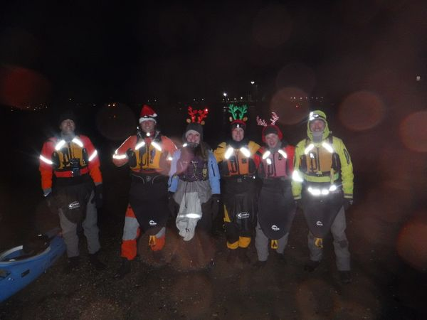
WHAT DID WE DO IN 2021?
Besides freezing….

Slide 5
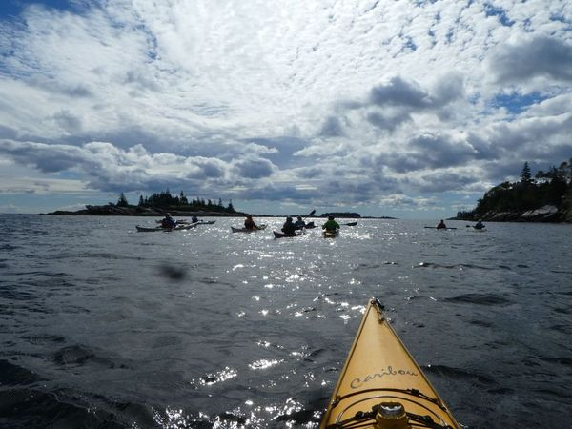
WE PADDLED AND LEARNED!
WHAT DID WE DO IN 2021?

Slide 6
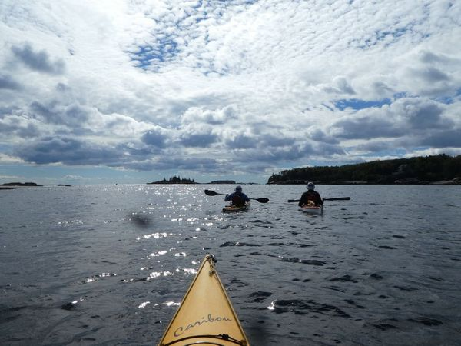
WE PADDLED AND LEARNED!
WHAT DID WE DO IN 2021?
62 paddling trips
16 hands-on skills sessions
11 presentations
6 pool sessions on three dates
And Tom Allen made 700!!

Slide 7
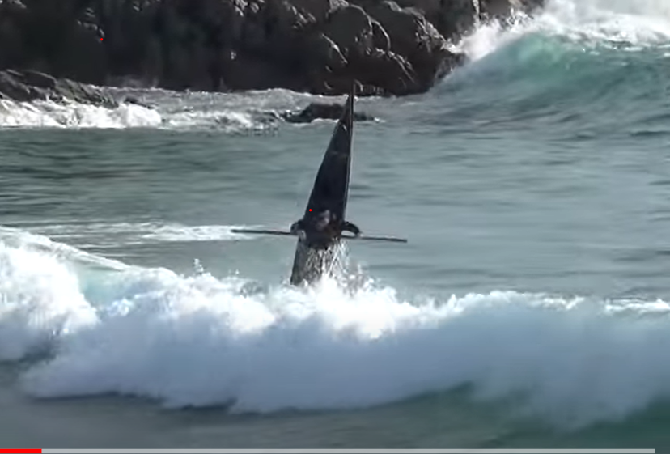
II. Trip (“Event”) Organizer Designation and Expectations
II. SKILLS COMMITTEE UPDATE
David Siegfried (Sig)
John Haile

Slide 8
SKILLS COMMITTEE
MEMBERS
David Siegfried
Cheri Perry
Maurik Holtrop
Cath Kimball
John Haile
John Rogers
Richard von Salza Brown

Slide 9
Upcoming Events: Planned and in Process
Pool Sessions
Professional Training
SMSKN Peer Training

Slide 10
2022 Pool Sessions
Sunday, January 30
Sunday, March 13
Sunday, April 10
1 – 4 pm; skills first half, open pool second half
Riverton Pool, Forest Avenue, Portland

Slide 11
Professional Training
John Carmody, BC Coastal Navigational and Tidal Planning: January 8 (+ second session)
Nancy Zane, Wilderness First Aid Afloat (WFAA) date TBD; stay tuned!

Slide 12
SMSKN Peer Training
Continued skills sessions: edging and bracing, rolling, rescues, etc.
Themed Paddles: training sessions followed by practice paddle
Mentored paddles: Partners for organizing or paddling

Slide 13
Survey coming!
What other training would you like?
Could you volunteer?

Slide 14
III. What’s New in SMSKN?

Slide 15
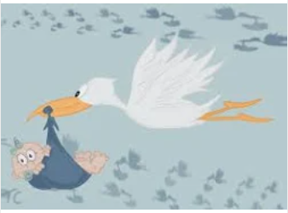
1. Adoption Announcement!
Deidre St. Louis

Slide 16
The adoption has been approved!

Slide 17
Is it a baby girl? A baby boy?

Slide 18
No. It’s a MITA island!

Slide 19
Our baby: Cow Island

Slide 20
Maine Island Trail
375 mile water trail extending length of Maine
Route is undefined
Connects over 240 islands and mainland sites which allow public access
Lands owned by various entities

Slide 21
MITA – Maine Island Trail Association
Non-profit based in Portland
Handshake agreements with landowners for public access
Multiple volunteer programs
Island adoption
Monitor skippers
Island clean-ups

Slide 22
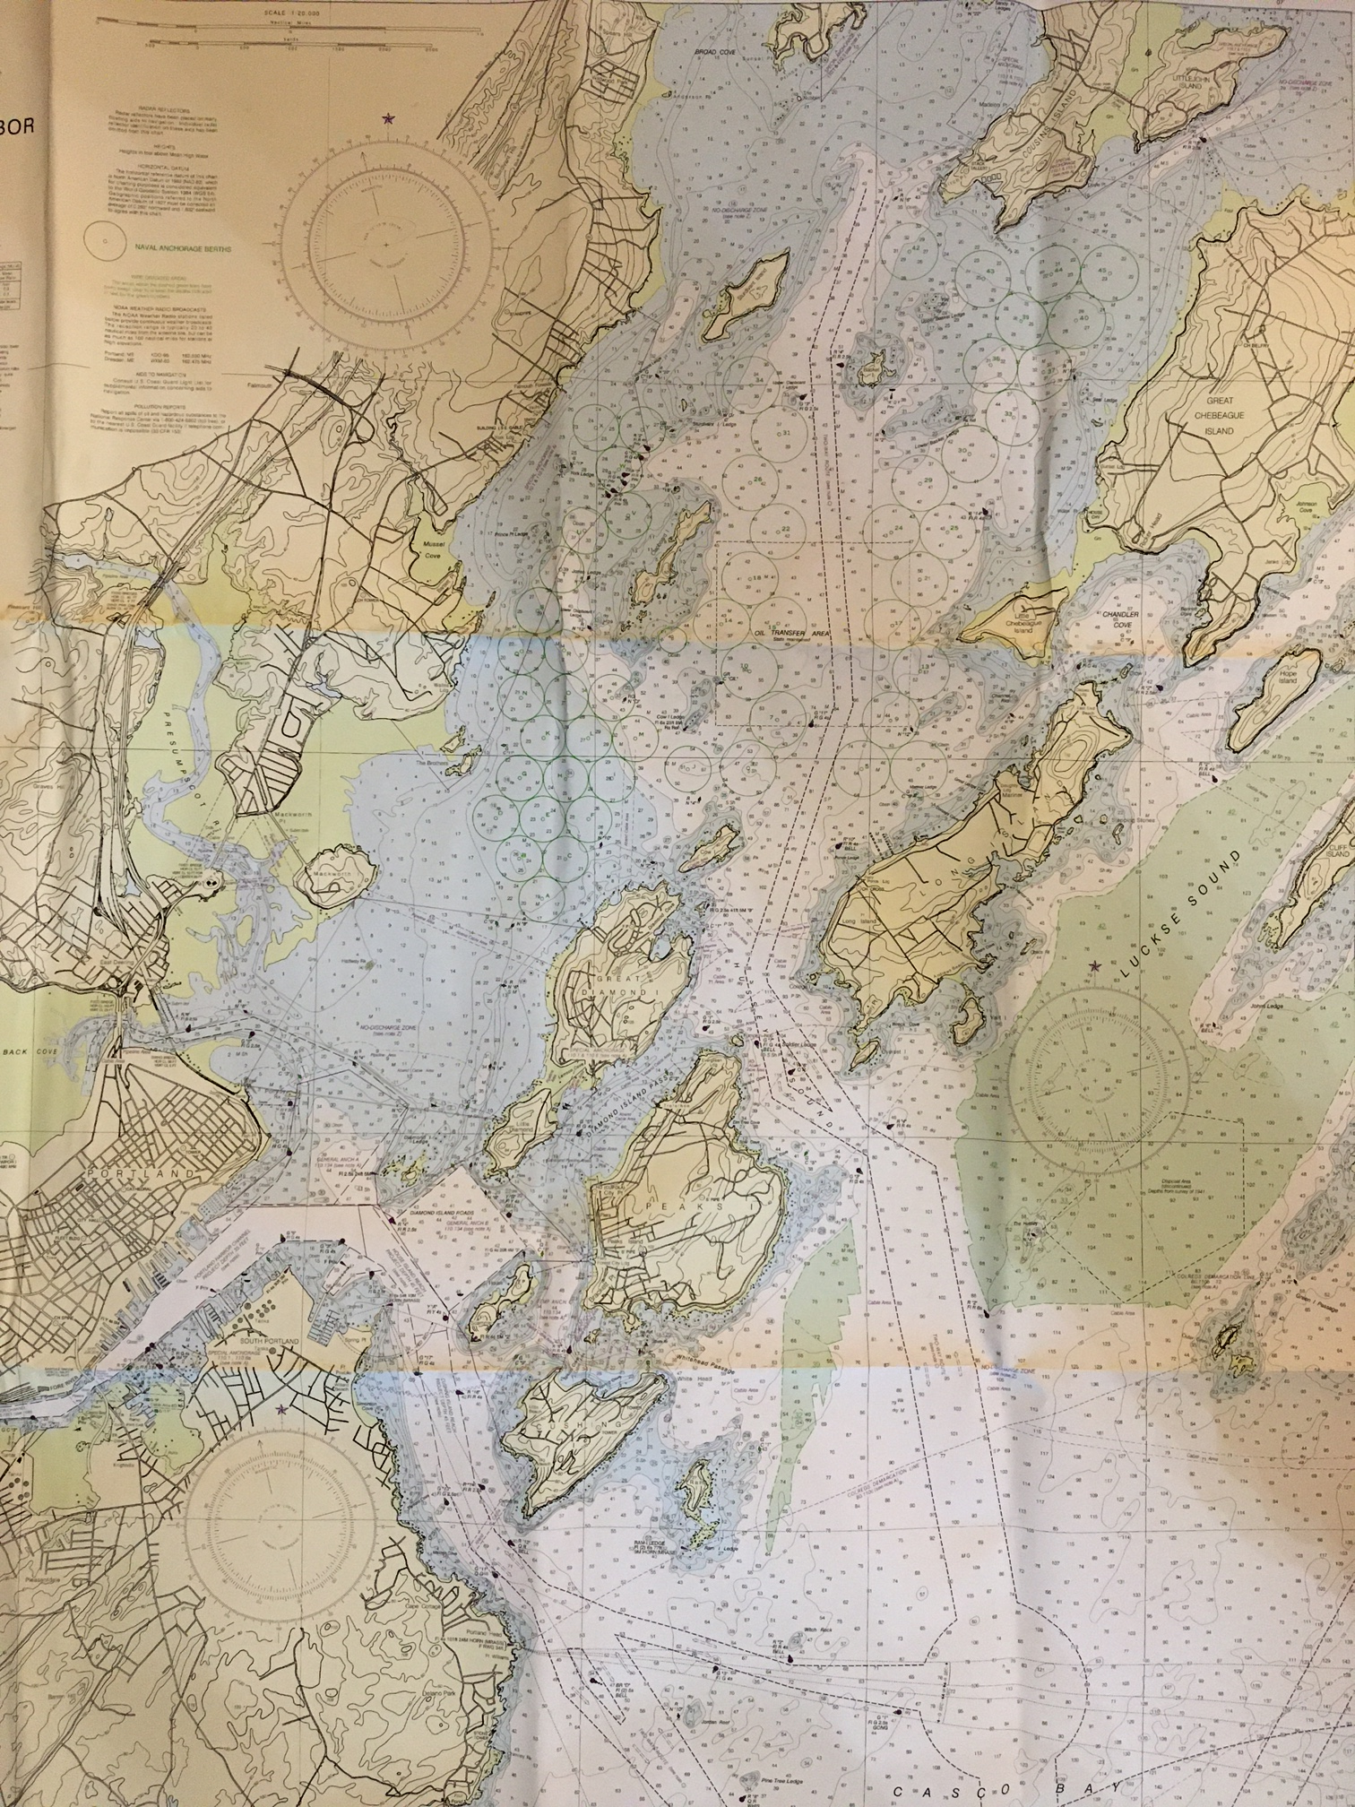
Great Chebeague Island
Falmouth
Cow
Portland
Peaks Island

Slide 23
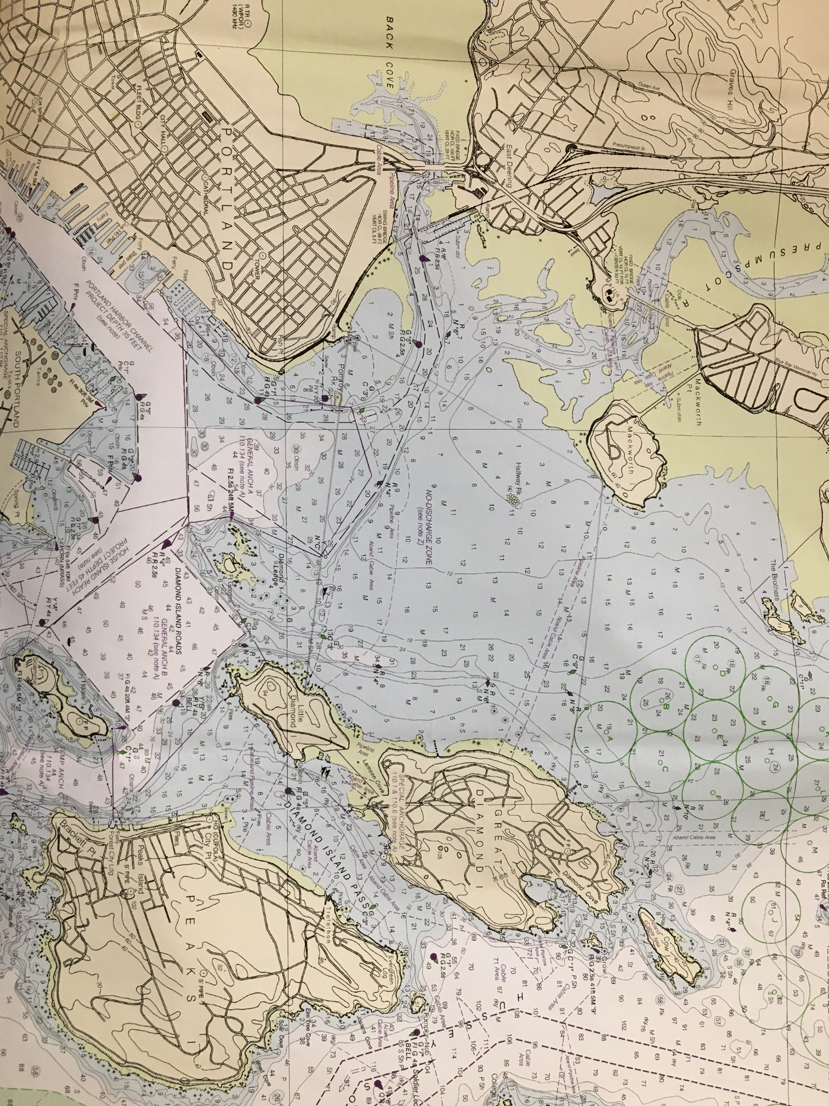
Cow
Great Diamond Island
East End Beach
~ 2.5 NM

Slide 24
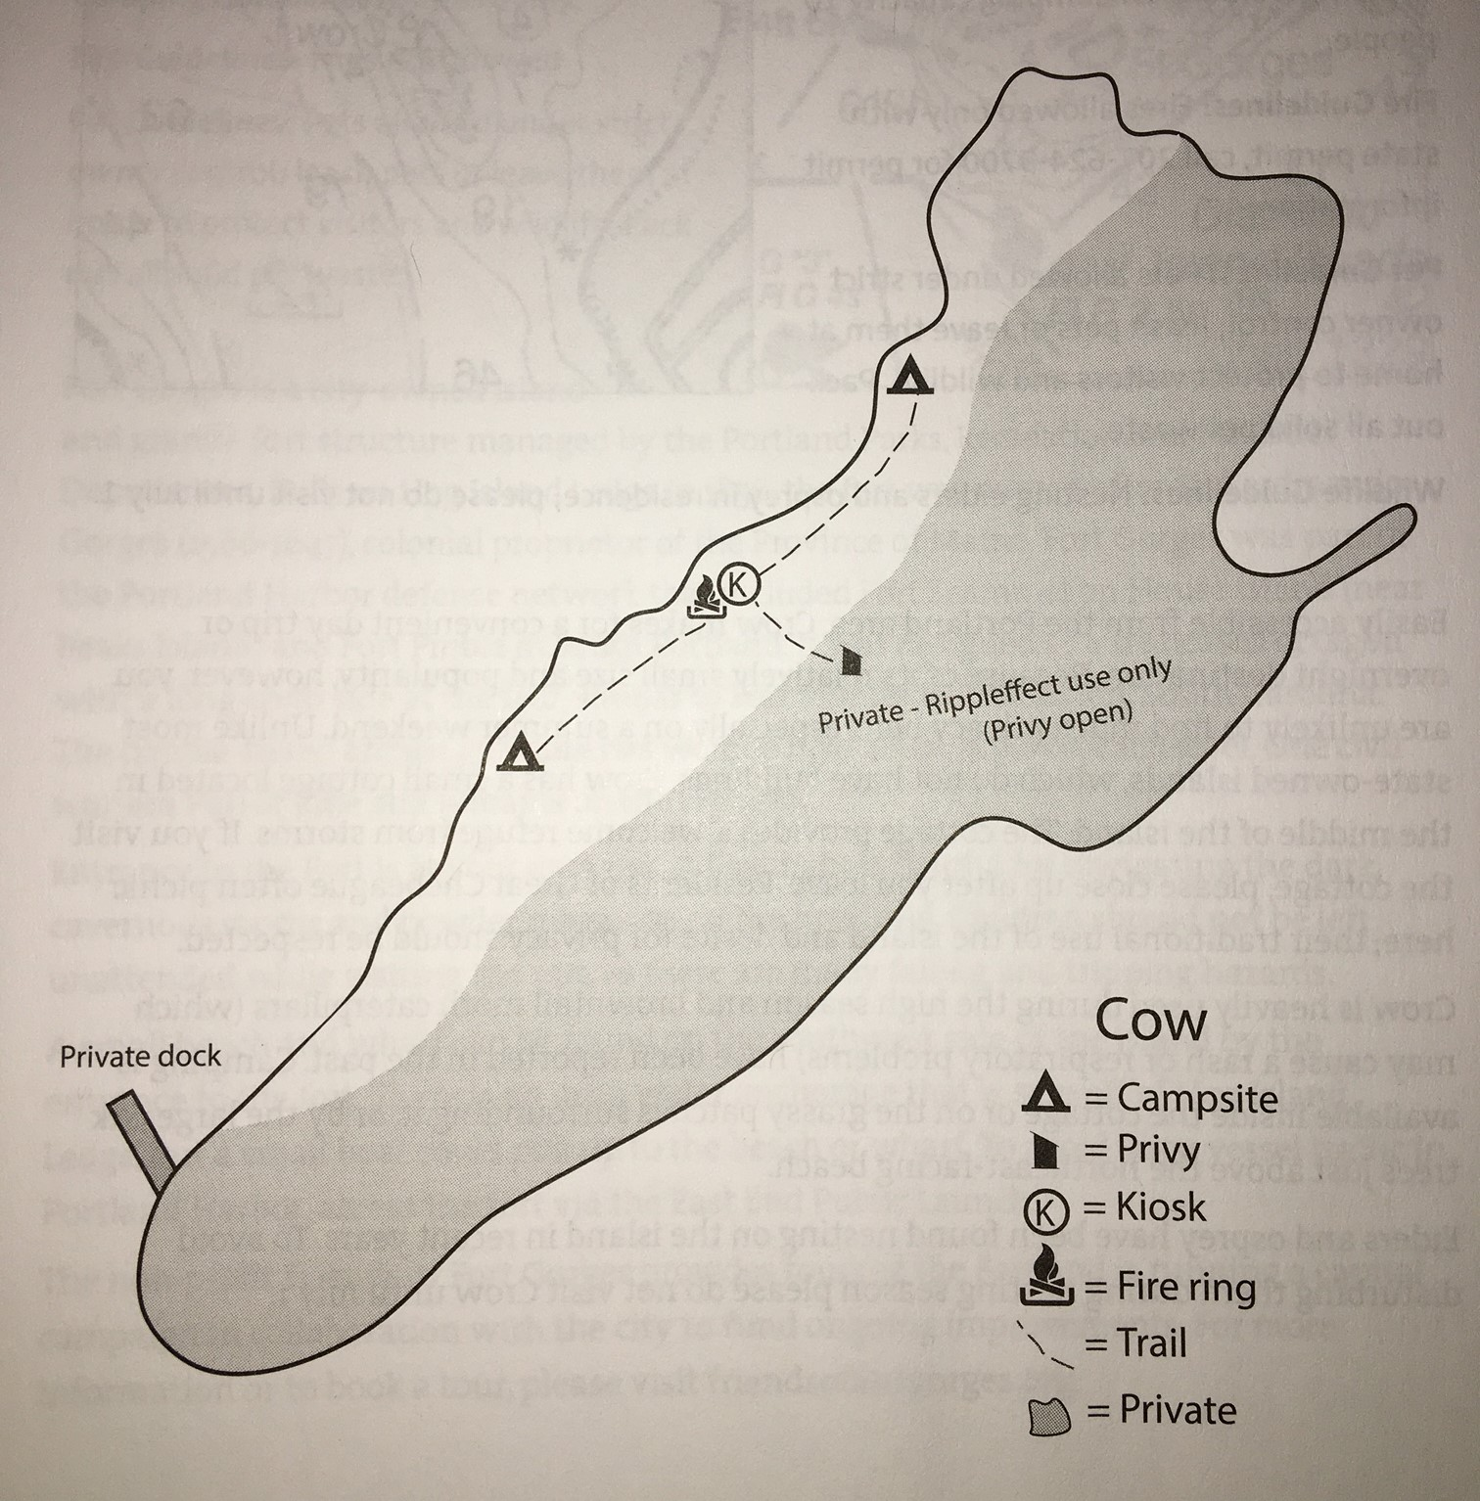
Cow Island
26 acres
Owned by Rippleffect
MCHT owns conservation easement
MITA stewards west side, where public access is allowed
2 campsites, trail, kiosk, fire ring
Private dock and east side for Rippleeffect use only

Slide 25
Parenting Duties
Visit at least monthly Memorial Day to Labor Day
Check island conditions
Pick up trash, do other needed clean-up
Interact with visitors to promote low impact use
Report back to MITA staff

Slide 26
Join the Adoption Team!
Adoption Team Tasks:
Coordinate monthly trips
Ensure monitoring tasks are completed
Report visits to MITA
How to get involved:
March meeting on Zoom.
Message Dee Dee St Louis through Meetup.

Slide 27
Contact info for organizations mentioned:
Maine Island Trail Association: mita.org
Maine Coast Heritage Trust: mcht.org
Rippleeffect: rippleffectmaine.org

Slide 28
2. Joint Trip Postings
Problem: “Joint” trip language incurs complete liability across both clubs
Solution: Courtesy Postings, sending attendees to other club’s website. See September 17 posting for AMC event.
Contact President to initiate

Slide 29
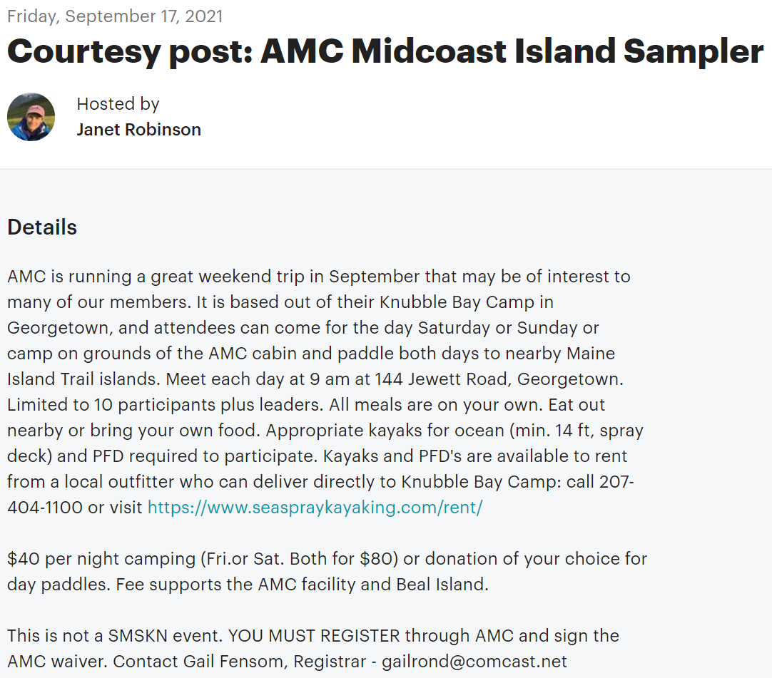

Slide 30
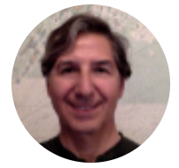
3. Membership Manager Update
John Contas

Slide 31
MM Role in SMSKN
Position formed in 2021
Role: to monitor and confirm signing of Participation Agreement (PA) by all SMSKN event paddlers

Slide 32
MM Updates and Changes
All SMSKN members required to sign PA prior to participating in a club paddle
PA easily accessible on SMSKN website under Club Documents: https://www.smskn.net/club-documents/1116-2/
Signing required only once!

Slide 33
MM Updates and Changes
Compliance monitored through SMSKN membership list for all club paddles posted on Meetup
Paddlers notified if not in compliance prior to paddling!
Good news - Compliance is very high!

Slide 34
MM Updates and Changes
New practice: LAST NAMES ON MEETUP PROFILE
PA Update and Re-signing: possibility for 2022

Slide 35
And speaking of Meetup…
Please make sure settings set to get emails of postings (check spam)
Please change your Meetup response if you can’t do a trip

Slide 36
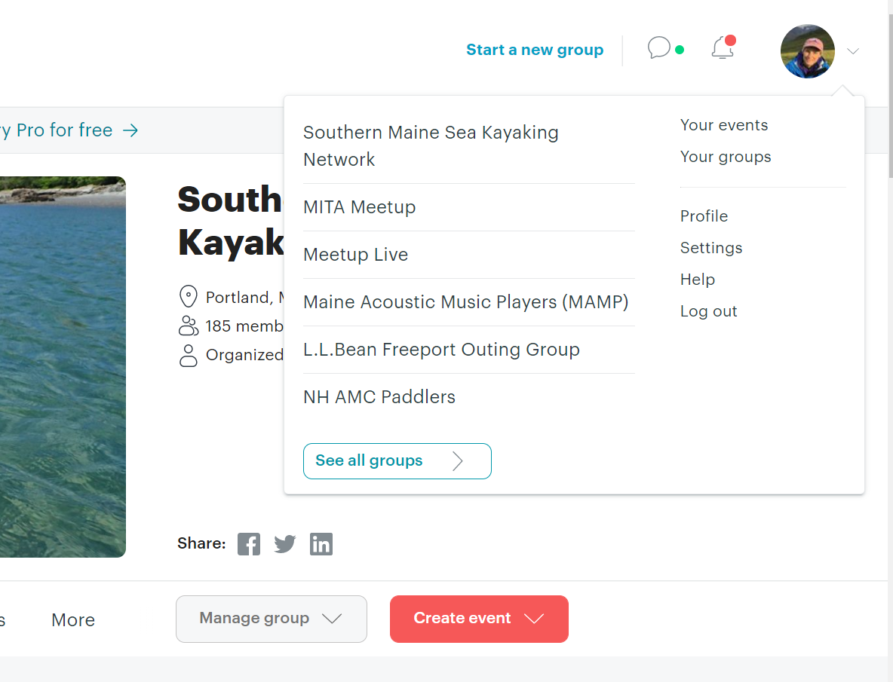
Settings and profile in URH corner

Slide 37
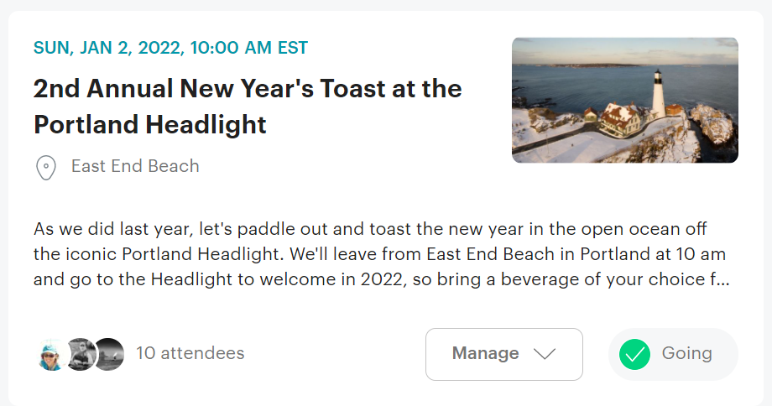
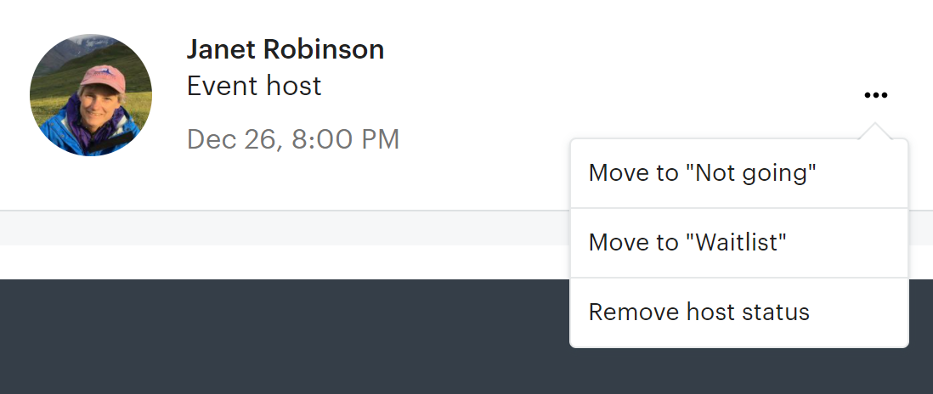
Attendance changed from Event Page
Click for list of participants
Click on dots to change response

Slide 38
4. And Finally …
LET’S CELEBRATE
1992
2022
30 YEARS!!

Slide 39
PARTY in Early Summer!
Cookout at Winslow Park (hopefully)(maybe)
Paddle swap – try different boats
Gear Swap – save your old gear!

Slide 40
PARTY in Early Summer!
Safety corner – trick up your ride
Honor past leaders
Eat, paddle, celebrate
Come help plan! Contact Janet

Slide 41
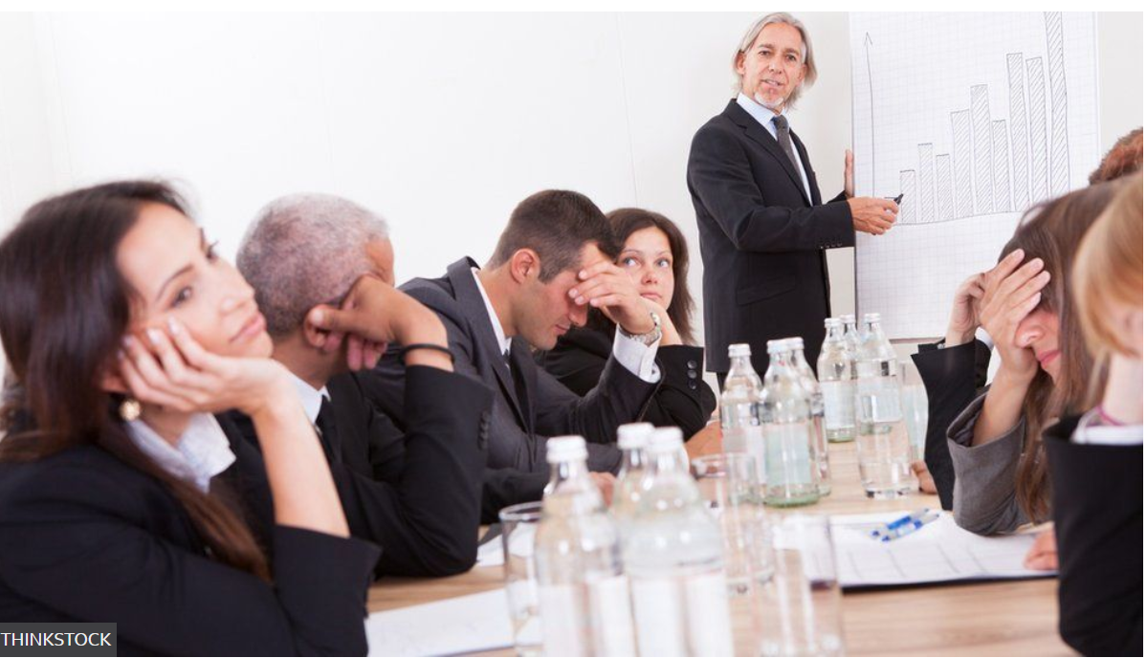
IV. Almost done… BOARD MEMBER ELECTIONS

Slide 42
Board Changes
Departing:
Tom Carr
David Siegfried (“Sig”)

Slide 43
Board Changes
Continuing:
Greg Fergin (Recording Secretary)
Chip Woodman (Treasurer)
John Contas (Membership Manager)
Vytas Marculionus (webmaster)
Jenna Ginsberg (at large)

Slide 44
Board Changes
FOR ELECTION
John Haile
Nananda Col
Joe Herlihy

Slide 45
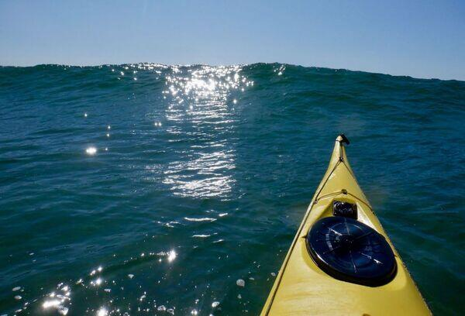
QUESTIONS ?
THOUGHTS?
COMMENTS?

Slide 46
Here’s to 2022!!!!

