Slide 1
CALLING ALL EVENT ORGANIZERS!
2022 Event Organizers Meeting
Janet Robinson
May 19, 2022

Slide 2
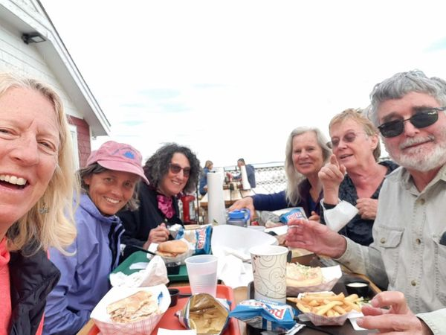
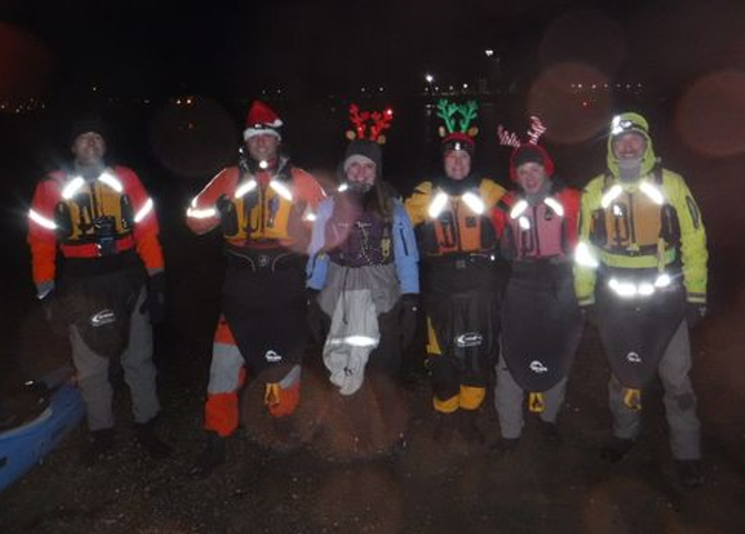
WHY POST???
Make New Friends
Do Quirky Trips

Slide 3
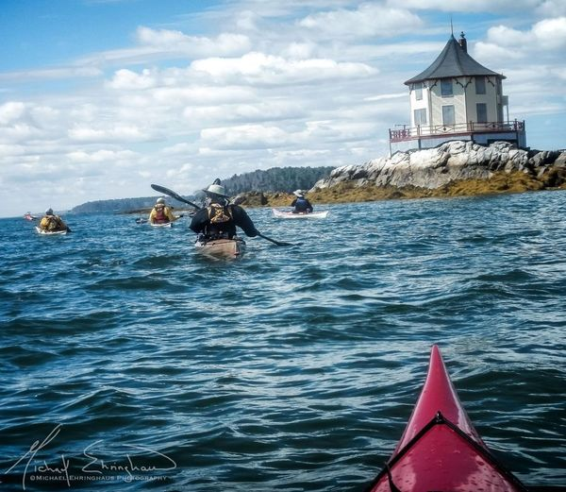
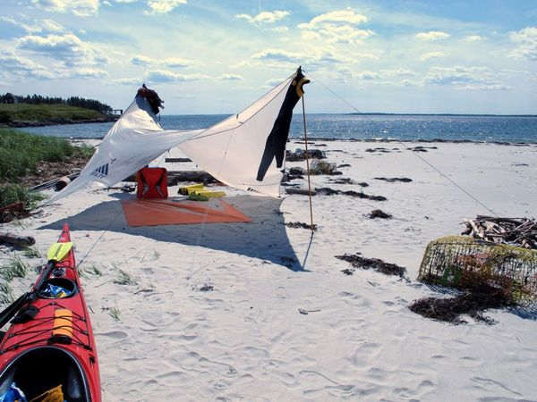
WHY POST???
Do More Paddling
Go camping

Slide 4
AND: To Keep our Club Going!

Slide 5
What We’ll Talk About
I. What to post: what makes a SMSKN trip
II. Who can post trips
III. Expectations of Event Organizer
IV. Mentor Program
V. How to work the Meetup page

Slide 6
I. What Makes a “SMSKN” Trip?
Mission statement provides guidance…

Slide 7
“The Southern Maine Sea Kayaking Network (SMSKN) is an organization for ocean-going sea kayakers to meet paddling friends, learn about safe paddling, and plan trips together.”
Meetup page, 2022
In short: community and safety

Slide 8
Southern Maine Sea Kayaking Network (SMSKN) is an organization for ocean-going sea kayakers to meet paddling friends, learn about safe paddling, and plan trips together.
Where we paddle:
Open ocean or bays
Tidal rivers
NOT inland lakes or rivers

Slide 9
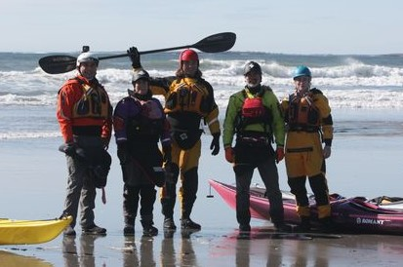
Why? Ocean and inland paddling communities vary widely
≠
Ocean paddling requires unique skills and safety practices

Slide 10
Southern Maine Sea Kayaking Network (SMSKN) is an organization for ocean-going sea kayakers to meet paddling friends, learn about safe paddling, and plan trips together.
Approximately 16+ ft. boats with sealed bulkheads; pfds, spray skirts required
NOT SUPs, sit-upons, pedal-driven, fishing kayaks, whitewater boats

Slide 11
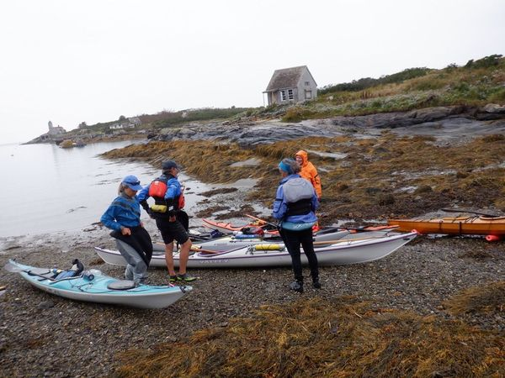
Why? To maintain consistency in approach, skills and expectations
This Means:
Safer trips
More enjoyable trips
MORE trips
≠

Slide 12
II. Who Can Post Trips?

Slide 13
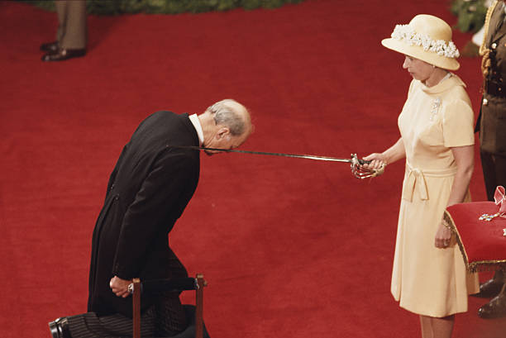
Meetup “Event Organizer” Designated by President

Slide 14
What is an Event Organizer?
Member who conceives of and can initiate a trip by a Meetup post
Plays same role as a trip initiator among friends!

Slide 15
What an Event Organizer is NOT:
“Leader”
“Guide”
Responsible for everyone’s safety
“In Charge” of the trip
Trained, approved, or certified, skilled
All members take responsibility for their own safety, equipment, skills, and conduct during each event

Slide 16
Qualifications?
No formal procedural criteria or training requirements, but-
Moderately experienced; not a beginner
Willing to follow basic club guidelines and safe boating practices
See “Guidelines for Trip Organizers” on smskn.net/Trip Planning

Slide 17
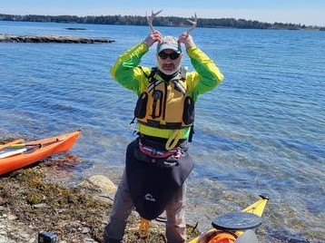
III. Expectations of Event Organizers

Slide 18
Event Organizer Duties
Think up a fun trip
Post an accurate description on Meetup
Communicate with attendees
Make the go/no go decision on both the TRIP and PARTICIPANTS
Hold a pre-launch meeting
Monitor group enroute

Slide 19
1. What’s a “Fun”Trip?

Slide 20
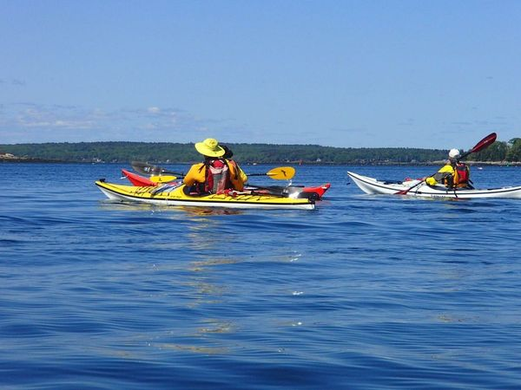
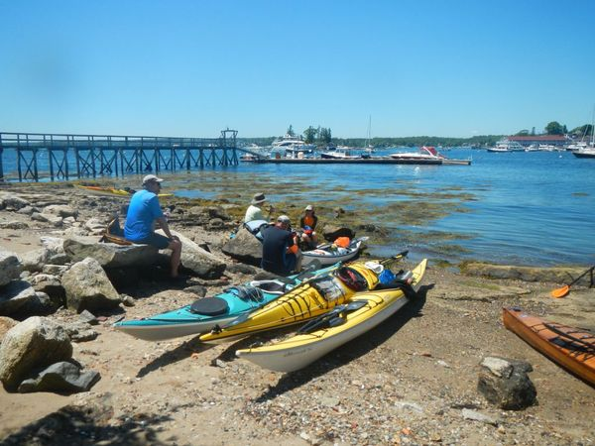
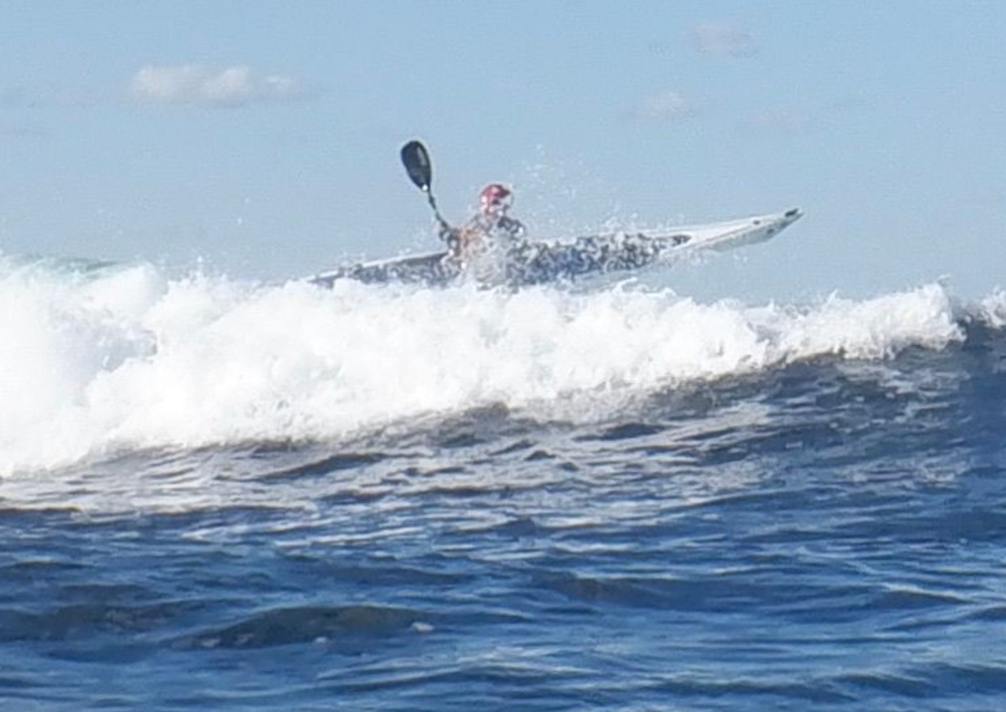
Whatever YOU Enjoy!

Slide 21
Interests are Diverse
SMSKN Board does not arrange or provide trips
Our members make the trips happen!
Quiet water, rough water, theme-based; all okay

Slide 22
What NOT to Post:
“JOINT TRIPS” with other clubs; use Courtesy Post instead to avoid liabilities. Contact President (=“Organizer”)
Vendor trips or events; use Discussions page if of particular interest to members.

Slide 23
2. Post an Accurate Trip Description
Description is THE most important means of making sure people can choose trips within their abilities
Accuracy and clarity important
No surprises!

Slide 24
Minimum Info for a Trip Description
Description of route or activity, noting highlights or challenges
Trip length in nautical miles
Trip duration: departure and return time
Boat or gear requirements (e.g. helmets, boat length, lights)
Immersion protection needs (dry suits, wet suits, etc)
Weather? Be speculative. Best - have attendees monitor. Wind speed in knots.

Slide 25
3. Communicate with Attendees
Watch posting for comments and questions; respond promptly
Can request personal contact by attendees for evaluation
Update posting if weather changes
Make sure your Meetup settings are set to get messages and notifications by email

Slide 26
4. Make Go/No Go Decisions
Event Organizer can cancel trip due to weather, group size, other factors
Event organizer can also turn away attendees with insufficient skills or equipment

Slide 27
Important: It’s okay to turn people away!
Wrong boats: e.g. too short, no sealed bulkheads, poor condition, etc.
Gear: e.g no pfd, spray skirt
Immersion protection: insufficient for season; dry suit in cold water
Skills: insufficient for conditions
ANYTHING ELSE!!
NECESSARY FOR SAFETY OF WHOLE GROUP

Slide 28
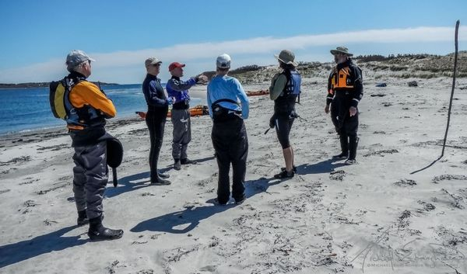
5. Hold a Pre-launch Meeting

Slide 29
5. Hold a Pre-launch Meeting
Discuss day and route with group before leaving
Weather, tides, route, challenges, etc.
Helps attendees gage suitability
Note that everyone responsible for own safety, but watch out for each other.
Ensure that everyone has signed Participant Agreement. John Contas will let you know if someone hasn’t. Have hard copies on hand.

Slide 30
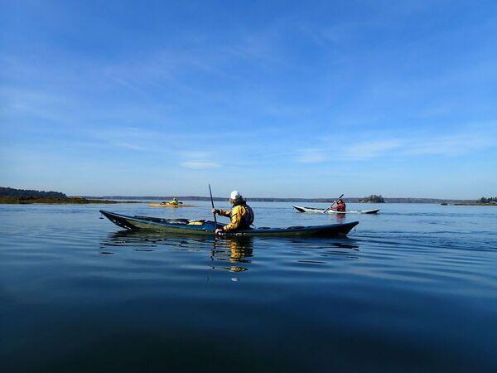
6. Monitor Group Enroute

Slide 31
What does Monitoring Mean?
Keep track of people; count!
Keep track of schedule and route
Confer with group on changes or conditions
OKAY for group to split

Slide 32
THAT’S IT!

Slide 33
BEYOND SMSKN: Additional Safety Practices Recommended!
Radio use
Float Plans
Emergency gear, etc. etc.
See Kayak Hipster:
https://www.youtube.com/watch?v=u8pEZiUeEPw­

Slide 34
Interested? Not Quite Sure??

Slide 35
Mentor Program in Works!
Experienced Members to help with posting, possibly attend trip
Demonstration trip for prospective or new Event Organizers
Brought to you by our Skills Committee!

Slide 36
QUESTIONS?

Slide 38
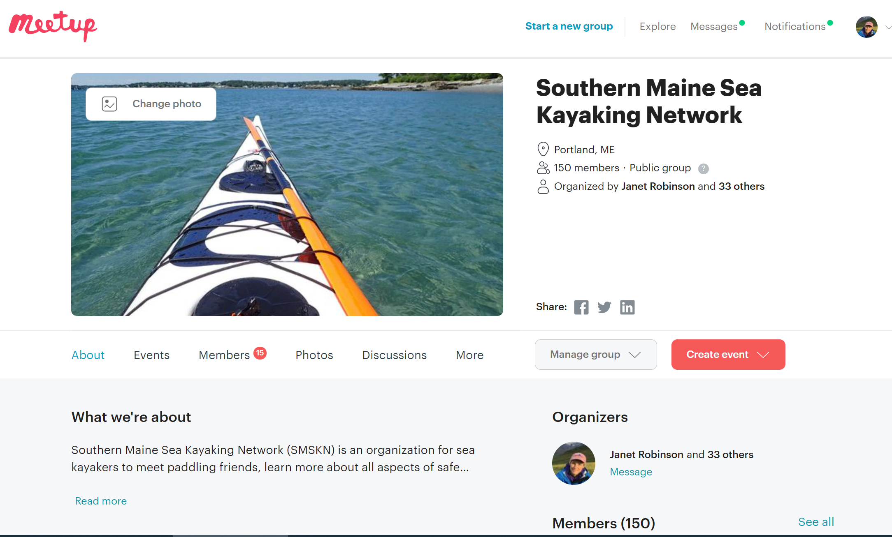
How to post a trip
START HERE

Slide 39
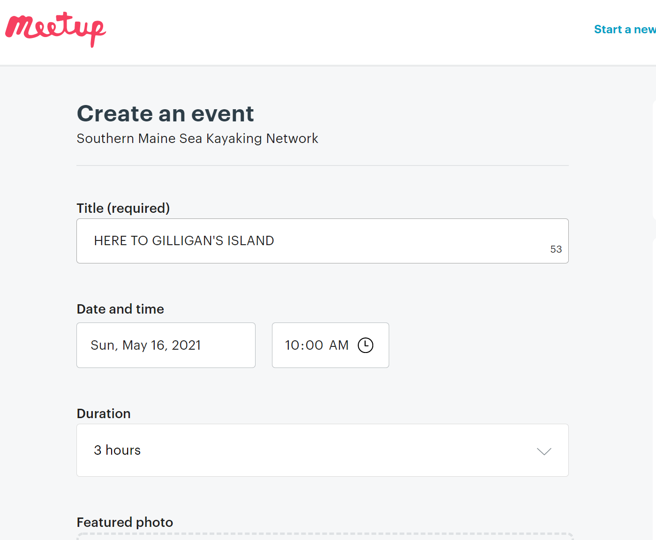
FILL OUT DETAILS
LAUNCH TIME, unless otherwise noted
BE GENEROUS

Slide 40
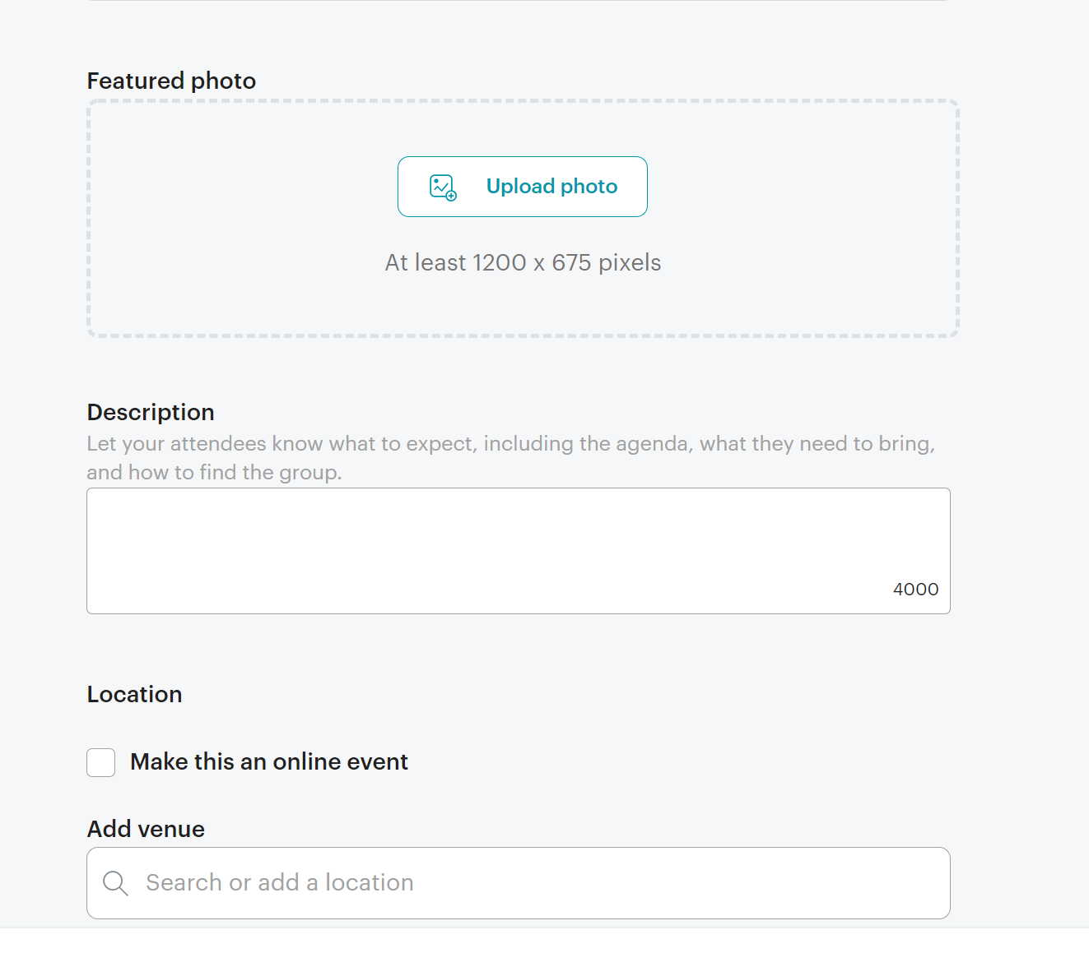
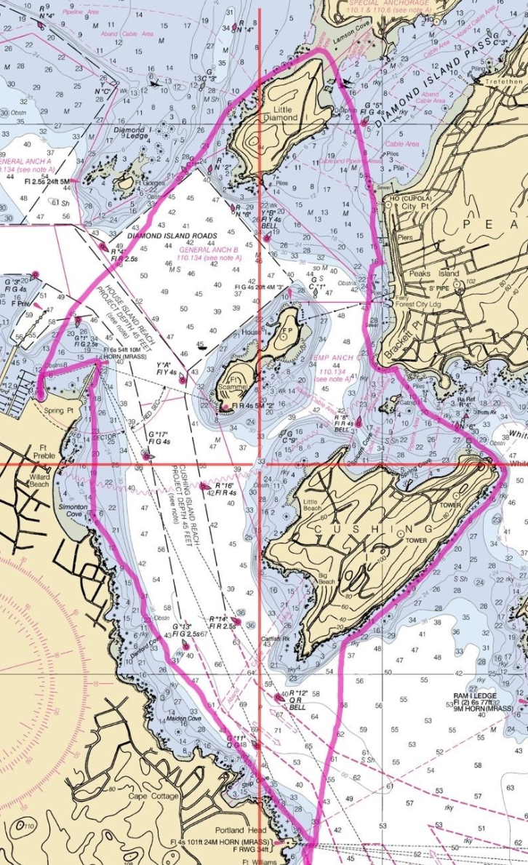
PICTURES
ARE NICE
Loading
Sometimes
Problematic
Can illustrate
Route here
MOST IMPORTANT SECTION!

Slide 41
Provide enough information so that members can tell if this trip is within their abilities and gear
Route description
Trip length, NM
Challenges
Trip level (smskn.net/Trip Planning)
Immersion Protection
Boat length, sealed bulkheads
Attractions, lunch stop, etc.
Group size (if any)
Be cautious about giving weather – it may change

Slide 42
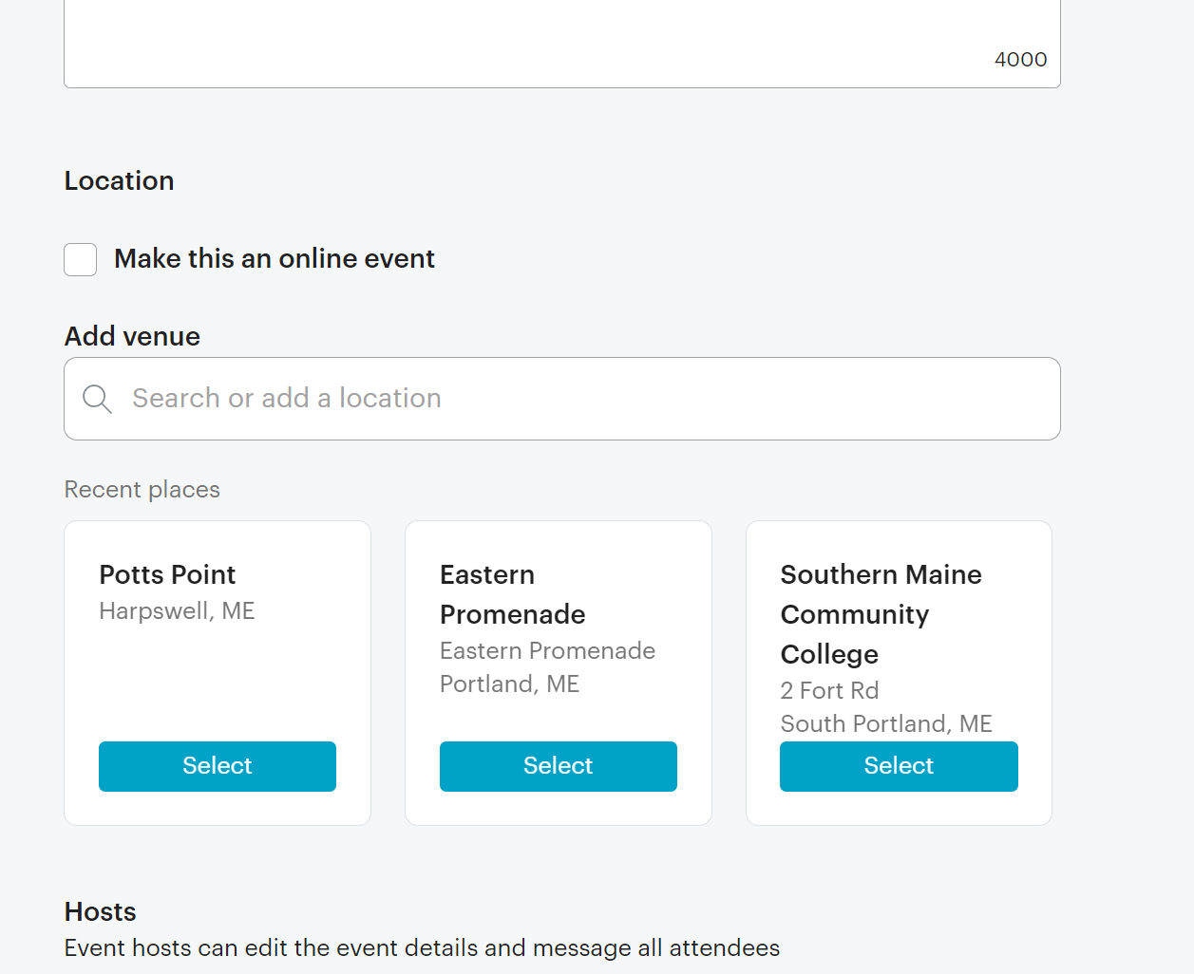
LAUNCH SITE:
MUST BE A GOOGLE MAPS LOCATION!!! Like below.
Then modify.

Slide 43
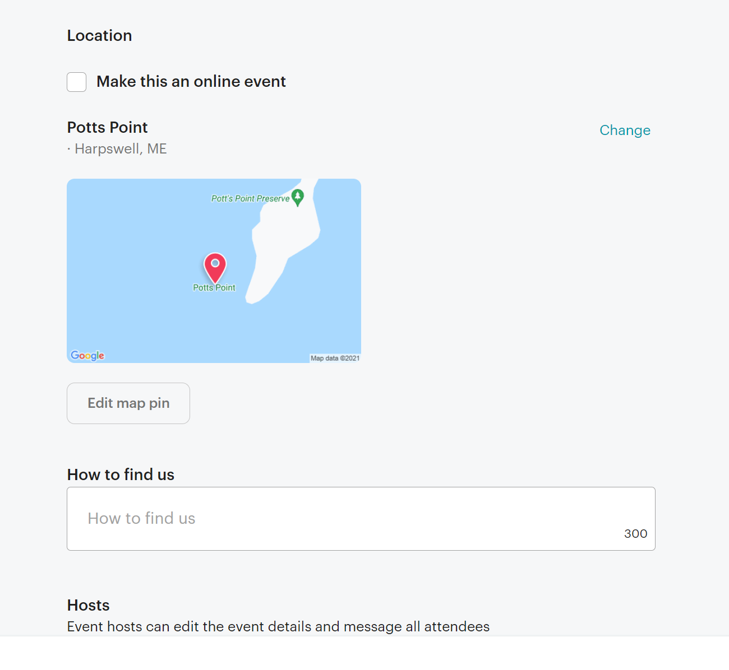
Use edit tool to move point to where you really want it.
Use this space to give details (“dirt road after third house on left…”

Slide 44
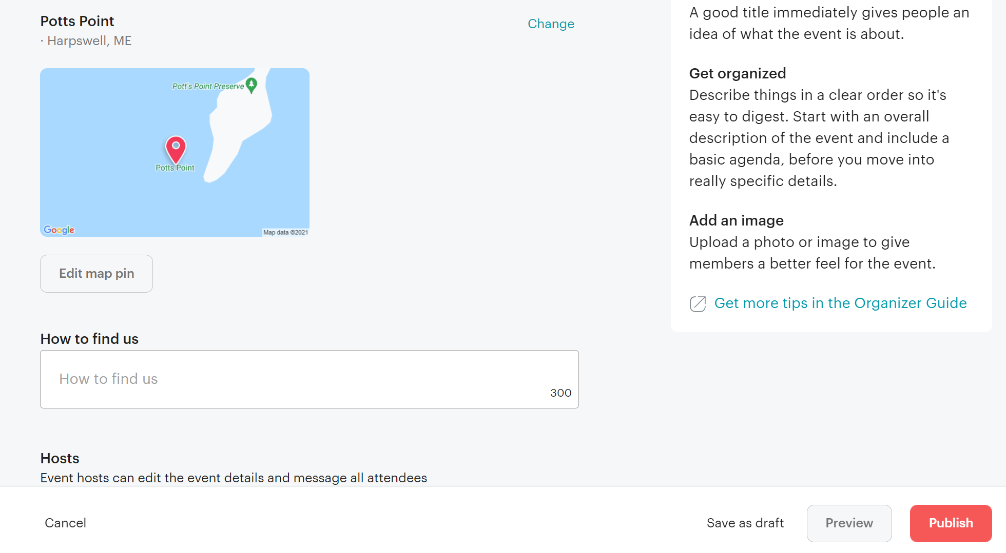
DO THIS FIRST!
Then this.

Slide 45
Next: Publish
Next: Announce
DONE!

Slide 46
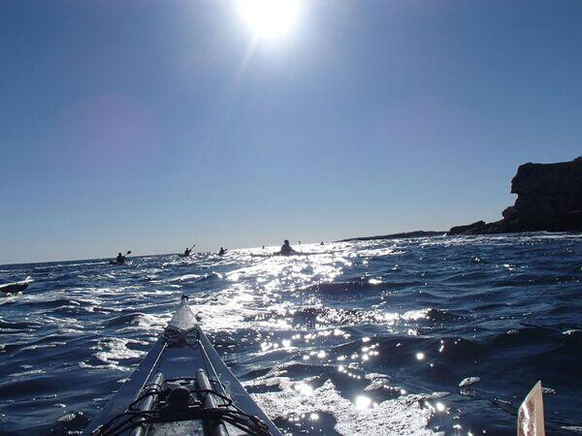
GO PADDLE!

