Slide 1
Cow Island

Slide 2
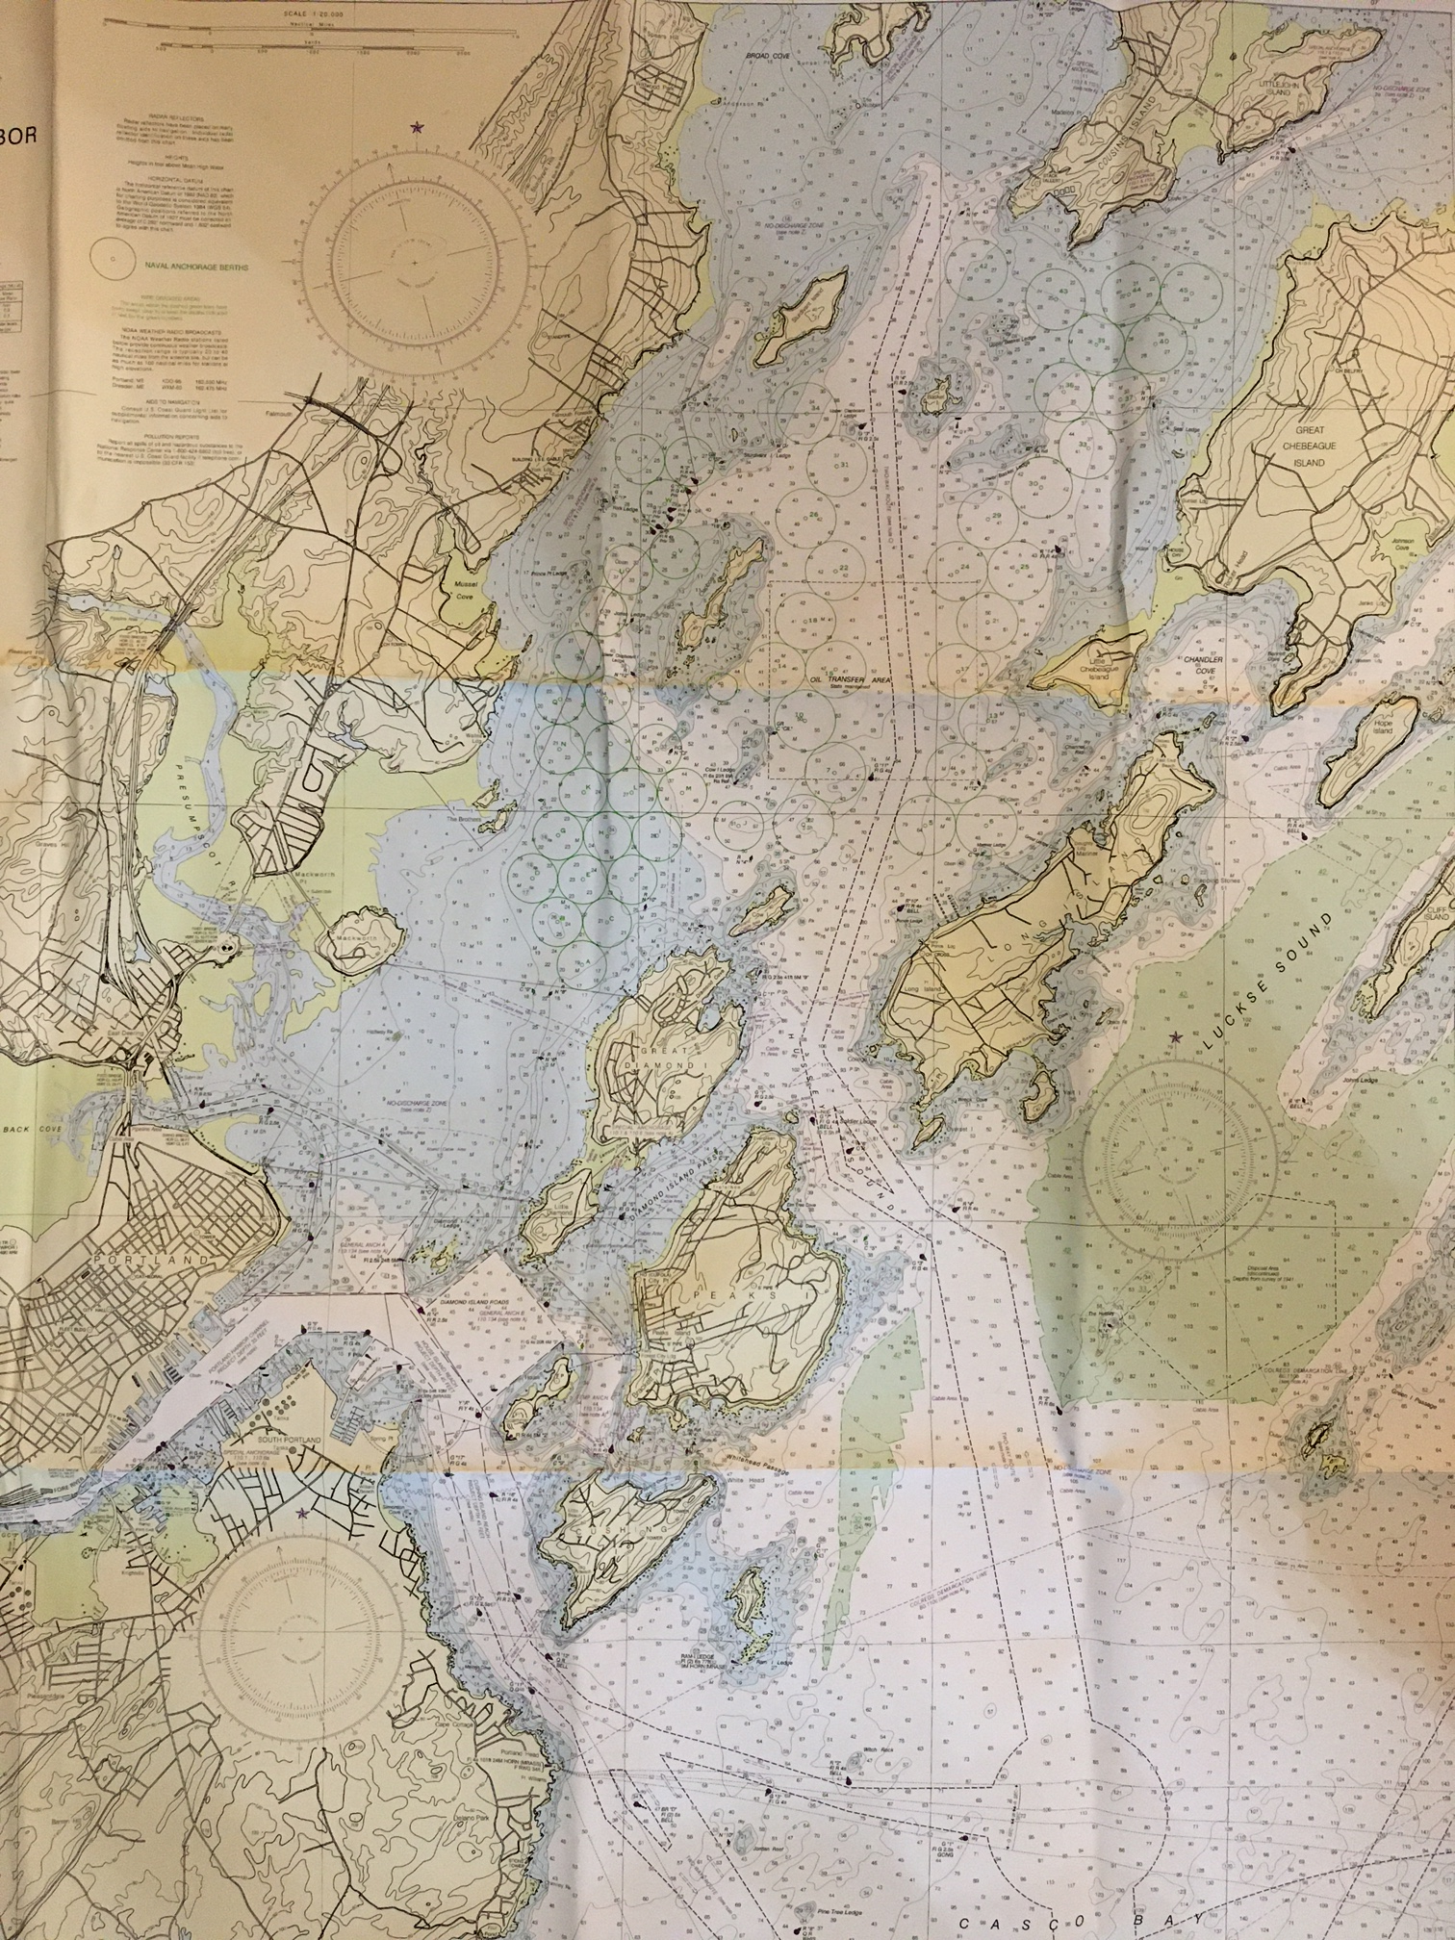
Great Chebeague Island
Falmouth
Cow
Portland
Peaks Island

Slide 3
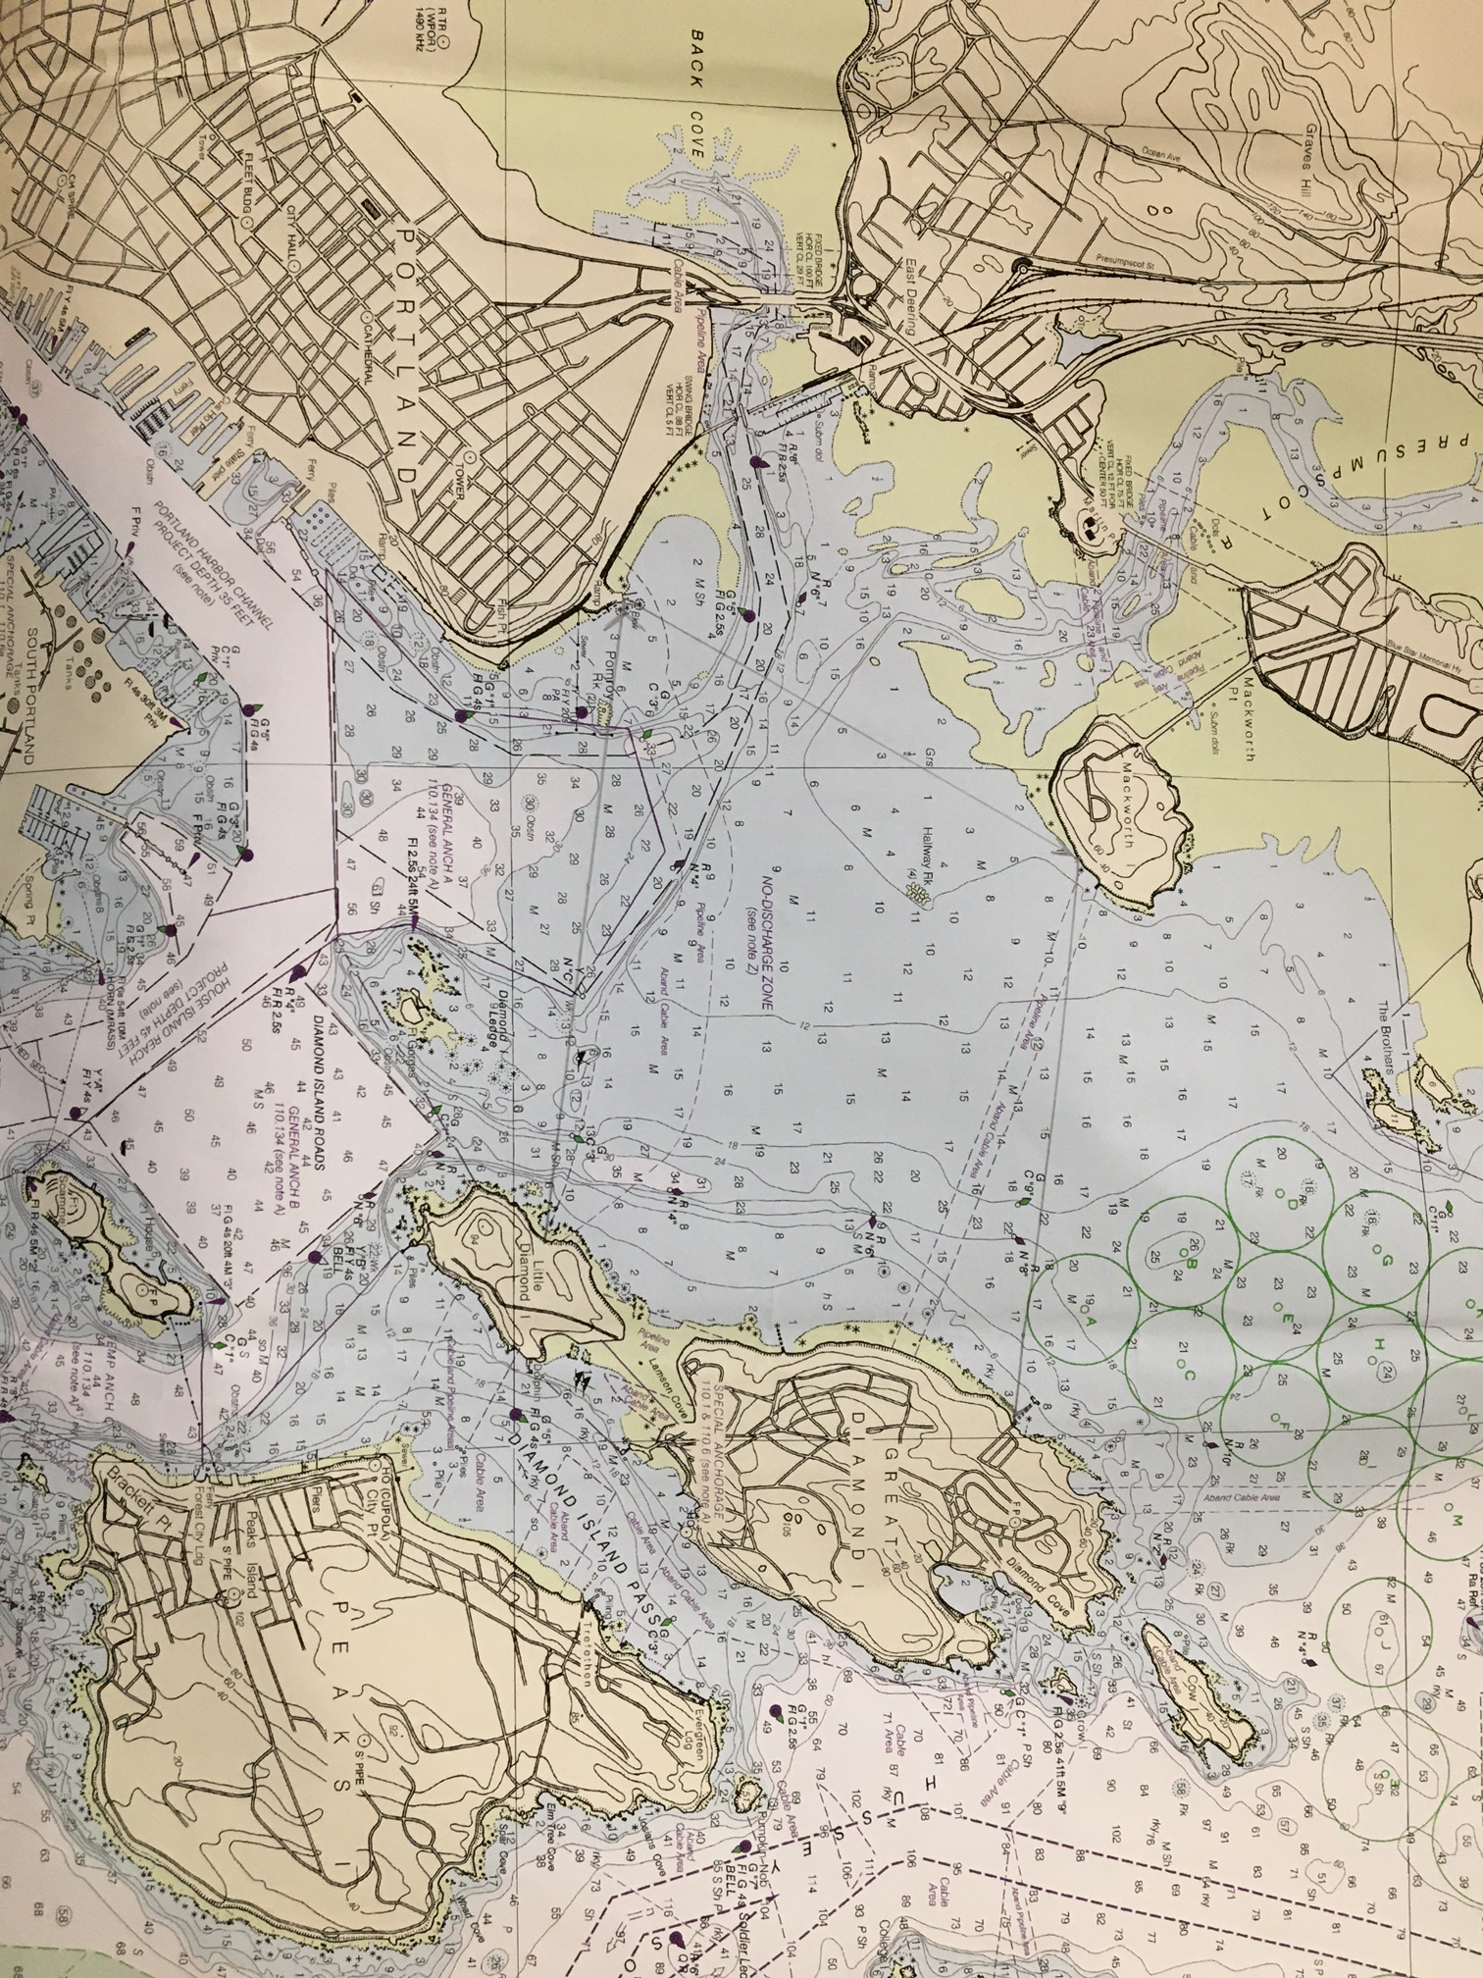
Cow
Great Diamond Island
East End Beach
~ 2.5 NM

Slide 4
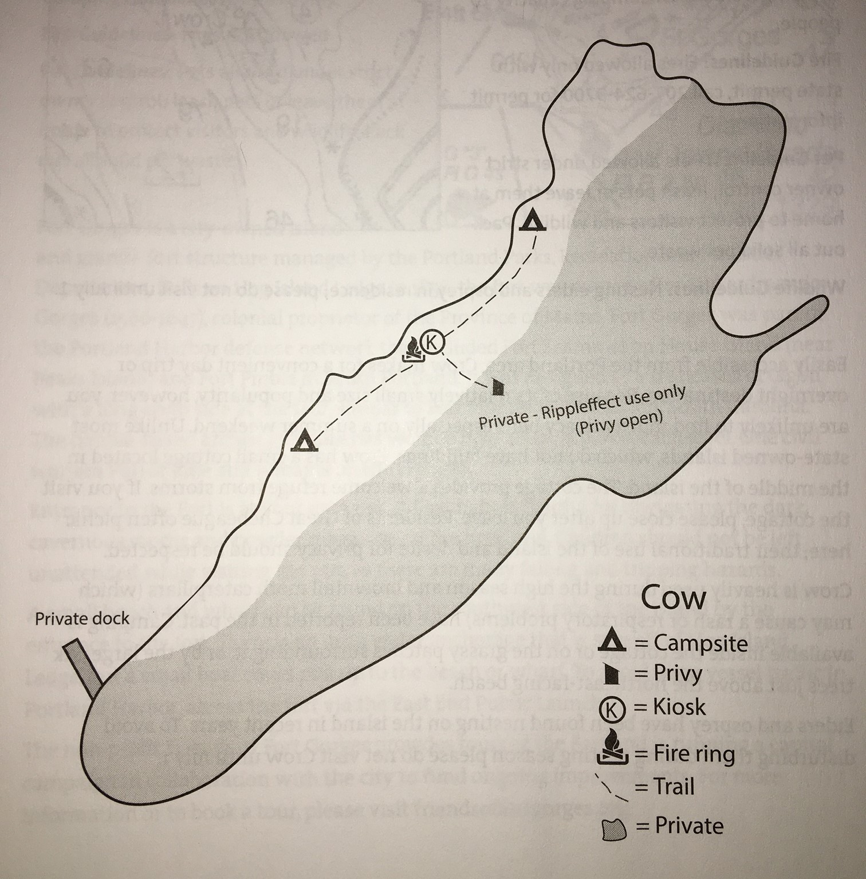
Cow Island
26 acres
Owned by Rippleeffect
MCHT owns conservation easement
MITA stewards west side, where public access is allowed
2 campsites, trail, kiosk, fire ring
Private dock and east side for Rippleeffect use only

Slide 5
Adoption Tasks
Visit at least monthly Memorial Day to Labor Day
Check island conditions
Pick up trash, do other needed clean-up
Interact with visitors to promote low impact use
Report back to MITA staff

Slide 6
Join the Adoption Team!
Adoption Team Tasks:
Coordinate monthly trips
Ensure monitoring tasks are completed
Report visits to MITA
How to get involved:
Message Dee Dee St Louis through Meetup.

